Slide 1

BASELINE APPROACH AND METHODOLOGY: SOUTH AFRICAN VULNERABILITY ASSESMENT COMMITTEE (SAVAC)
SAVAC TRT Meeting
28 January 2016

Slide 2
SAVAC Framework for Assessment
On 04 December 2015 the SAVAC endorsed the combination two different types of information:
Cross-sectional survey analysis
“Food Security Continuum”
Measuring a set of indicators to determine numbers of people that are food insecure, using various categorisations.
Provides with a food and nutrition security status quo at a point in time.

Slide 3
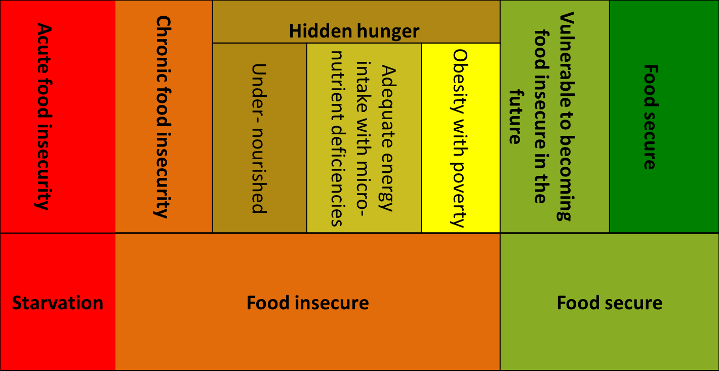
Continued…
Food Security Continuum

Slide 4
Continued…
2. Longitudinal projections and forecast analysis
“Livelihoods-Based Analysis” - HEA
Provides with an understanding of how people make a living – livelihood systems.
Provides a forecast analysis for food security and livelihood outcomes in the context of dynamic environment.
Necessary for planning and targeting of interventions.

Slide 5
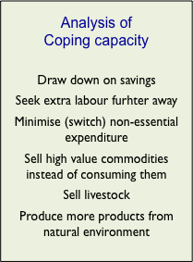
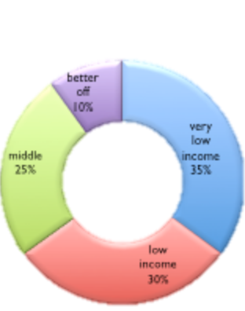
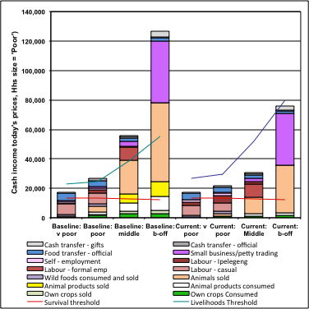
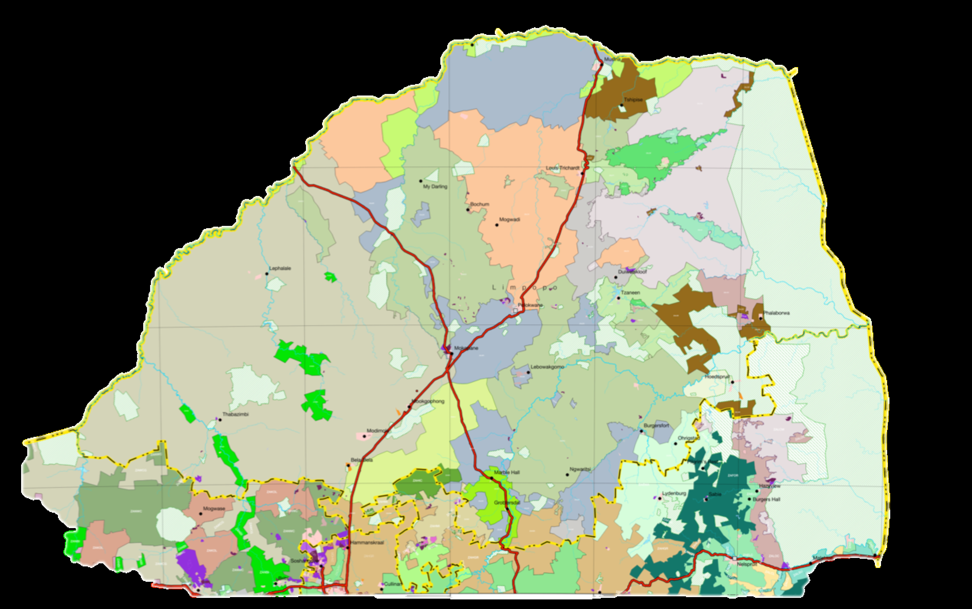
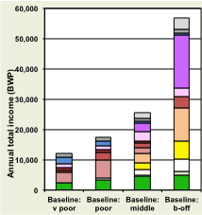
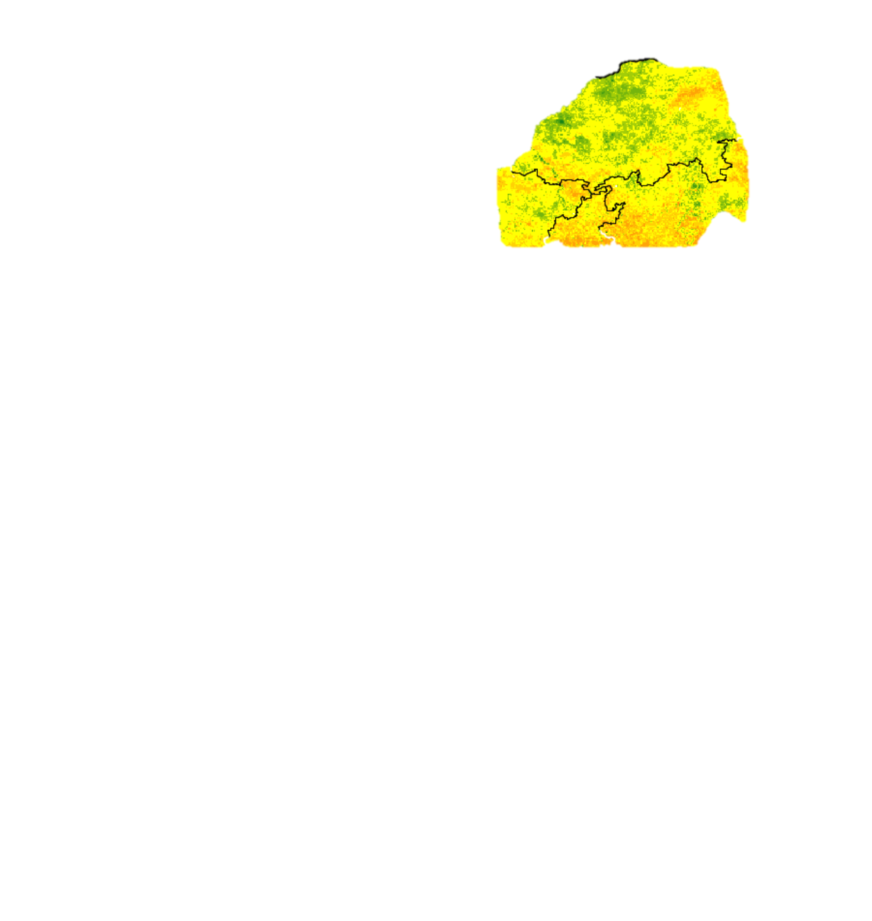

Continued…
HEA Baseline
HEA Outcome Analysis
Step 1
Step 2
Step 3
Step 4
Step 5
Step 6
Livelihood Zones
WealthBreakdown
Livelihood Strategies
Problem Specification
Projected Outcome
Crop production 60%
Livestock price 40%

Slide 6
Methodology
Data will be collected in 09 livelihood zones (10 districts).
A combination of secondary and primary data will be used.
Quantitative data will be collected through household survey and qualitative data was collected through Focus Group Discussions.
For the household survey:
Sampling still to be done using Stratified sampling according to population size
For Focus Group discussions:
For each village, one interview will be done with key informants and at least four interviews were done with different wealth groups (VP, P, M, WO).

Slide 7
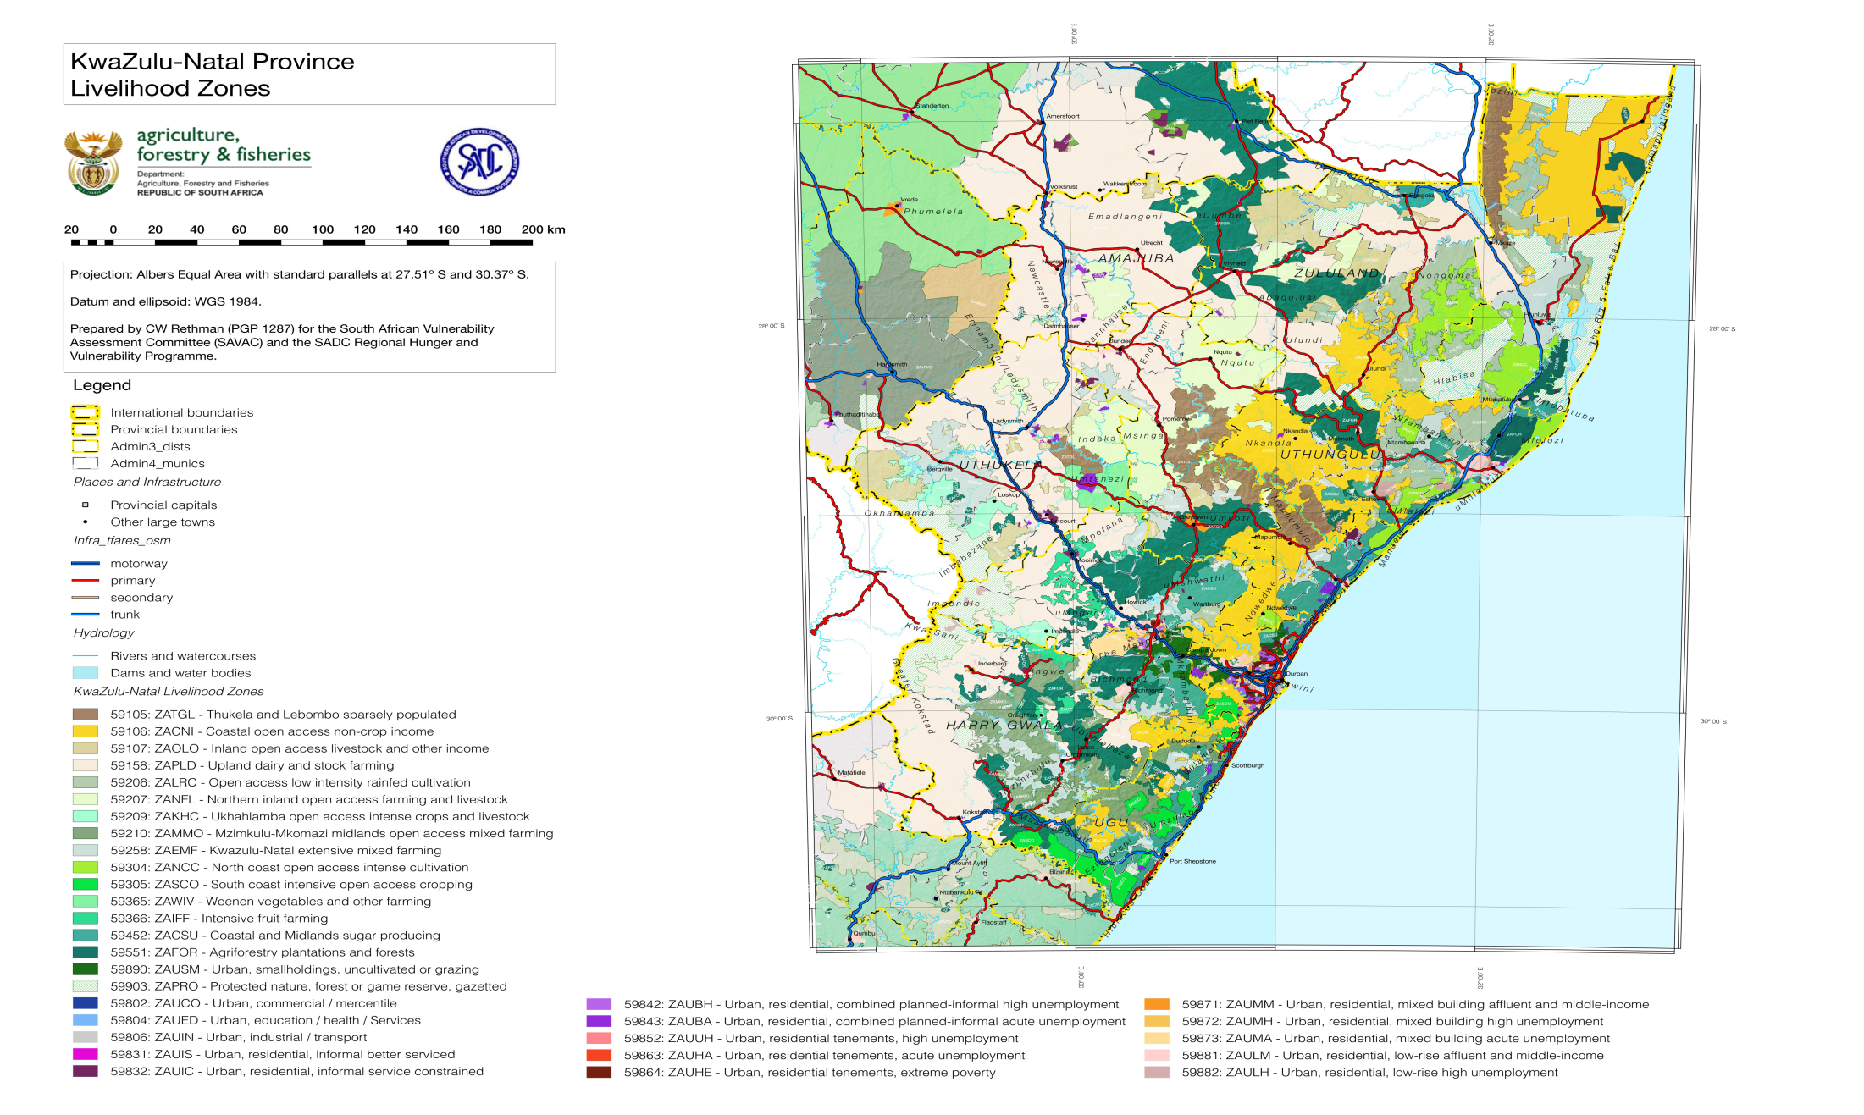
KZN Livelihood Zones

Slide 8
Selected Livelihood Zones
59105 – Thukela and Lebombo sparsely populated (ZATGL)
UThukela District: Indaka
UThungulu District : Nkandla
ILembe District : Maphumulo
UMzinyathi District : Msinga
UMkhanyakude District : Jozini (Mkhuze)

Slide 9
Continued..
59106 – Coastal Open Access Non – Crop Income (ZACNI)
UMkhanyakude District : Umhlabuyalingana, Mtubatuba
UThungulu District: Nkandla, Umlalazi (Eshowe)
Zululand District: Ulundi
Harry Gwala District
Ugu District: Vulamehlo (Dududu), Umdoni, Umuziwabantu
Umgungundlovu District: Umsunduzi (sweetwater), Umkhambathithi (Camperdown)
ILembe District: Maphumulo Ndwedwe
EThekwini Metropolitan: Umbumbulu

Slide 10
Continued
3. 59107 – Inland Open Access Livestock and other Income (ZAOLO)
- Amajuba District: Emadlangeni
- Zululand District: Abaqulisi
- UThukela District: Umnambithi, Ukhahlamba, Imbabazane
-Harry Gwala District: Kokostad
-Umgungundlovu: Umshwathi, Richmond
-UMzinyathi District: Umvoti
-Ugu District: Umzumbe

Slide 11
Continued
4. 59206 – Open Access Low Intensity Rainfed Cultivation (ZALRC)
- Umkhanyakude District: Jozini, Mkhuze, Hluhluwe, Hlabisa, Mtubatuba
- Zululand District: Nongoma
- UThungulu District: Mntambanana (Mbonambi), Mfolozi, Mhlathuze (Dlangubo, Umlalazi
-Ilembe District: Mandeni (Doorenkop), Maphumulo
-Umgungundlovu: Umshwati (Swaaiman)

Slide 12
Continued
5. 59207 – Northern Inland Open Access Farming and Livestock (ZANFL)
- Zululand District: Uphongolo, Abaqulisi, Idumbe
- Amajuba District: Dannhause
- UMzinyathi District: Nqutu (Babanango), Ulundi, Msinga
-UThukela District: Indaka, Ladysmith

Slide 13
Continued
6. 59209 – UKhahlamba Open Access Intense Crops and Livestock (ZAKHC)
- UThukela District: UKhahlamba
- Umgungundlovu: Impendle

Slide 14
Continued
7. 59210 – Mzimkulu – Mkomazi midlands open access mixed farming (ZAMMO)
- Harry Gwala District: Umzimkhulu, Ixopo
- Ugu District: Umuziwabantu, Umzumbe
- Umgungundlovu District: Richmond

Slide 15
Continued
8. 59304 – North Coast Open Access Intense Cultivation (ZANCC)
- ILembe District: Ndwedwe, Mandeni
- UThungulu District: Umlalazi, Ntambanana, Mthonjaneni, Umhlathuze (Sokhulu)
- UMkhanyakude District: Mtubatuba (Mpukanyoni)
-Zululand District: Nongoma (Buxene, Dabhasi)

Slide 16
Continued
9. 59305 – South Coast Intensive Open Access Cropping (ZASCO)
- EThekwini Metro: Mbumbulu, Umgababa
- Ugu District: Umzumbe (Hibberdene, Bhobhoyi), Ezinqoleni, Hibiscus Coast (Nzimakwe), Muziwabantu

Slide 17
THANK YOU!!!

